Slide 1
Enhanced Entity-Relationship

Slide 2
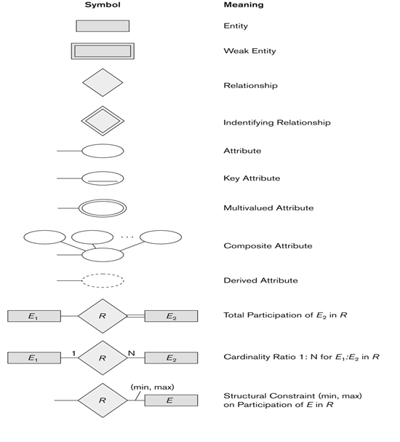
Summary of notation for ER diagrams

Slide 3
Enhanced-ER (EER) Model Concepts
Includes all modeling concepts of basic ER
Additional concepts: subclasses/superclasses, specialization/generalization, categories, attribute inheritance
The resulting model is called the enhanced-ER or Extended ER (E2R or EER) model
It is used to model applications more completely and accurately if needed
It includes some object-oriented concepts, such as inheritance

Slide 4
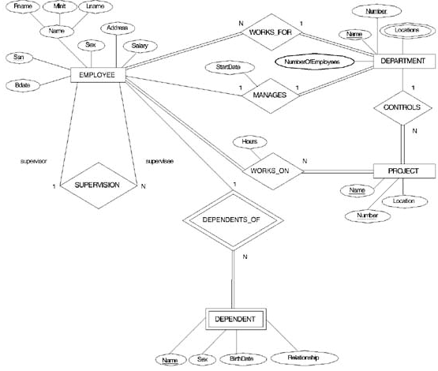
ER DIAGRAM FOR THE COMPANY DATABASE

Slide 5
Subclasses and Superclasses (1)
An entity type may have additional meaningful sub groupings of its entities
Example: EMPLOYEE may be further grouped into SECRETARY, ENGINEER, MANAGER, TECHNICIAN, SALARIED_EMPLOYEE, HOURLY_EMPLOYEE,…
Each of these groupings is a subset of EMPLOYEE entities
Each is called a subclass of EMPLOYEE
EMPLOYEE is the superclass for each of these subclasses
These are called superclass/subclass relationships.
Example: EMPLOYEE/SECRETARY, EMPLOYEE/TECHNICIAN

Slide 6
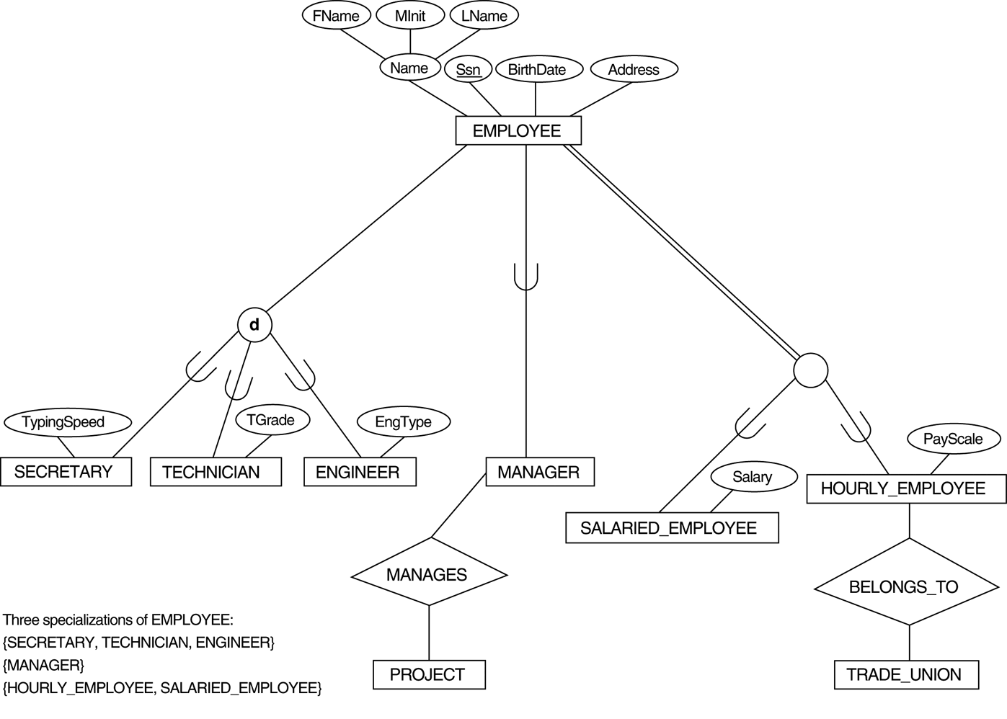
EER diagram notation to represent subclasses and specialization.

Slide 7
Subclasses and Superclasses (2)
These are also called IS-A relationships (SECRETARY IS-A EMPLOYEE, TECHNICIAN IS-A EMPLOYEE, …).
Note: An entity that is member of a subclass represents the same real-world entity as some member of the superclass
The Subclass member is the same entity in a distinct specific role
An entity cannot exist in the database merely by being a member of a subclass; it must also be a member of the superclass
A member of the superclass can be optionally included as a member of any number of its subclasses
Example: A salaried employee who is also an engineer belongs to the two subclasses ENGINEER and SALARIED_EMPLOYEE
It is not necessary that every entity in a superclass be a member of some subclass

Slide 8
Attribute Inheritance in Superclass / Subclass Relationships
The subclass is the same as the entity in the superclass, but in a distinct specific role
An entity that is member of a subclass inherits all attributes of the entity as a member of the superclass
It also inherits all relationships
Subclass can have its own specific attributes and relationships
Subclass entity is related via the key attribute to his superclass entity

Slide 9
Attribute Inheritance in Superclass / Subclass Relationships
An entity that is member of a subclass inherits
All attributes of the entity as a member of the superclass
All relationships of the entity as a member of the superclass
Example:
In the previous slide, SECRETARY (as well as TECHNICIAN and ENGINEER) inherit the attributes Name, SSN, …, from EMPLOYEE
Every SECRETARY entity will have values for the inherited attributes

Slide 10
Specialization (1)
Specialization is the process of defining a set of subclasses of a superclass
The set of subclasses is based upon some distinguishing characteristics of the entities in the superclass
Example: {SECRETARY, ENGINEER, TECHNICIAN} is a specialization of EMPLOYEE based upon job type.
May have several specializations of the same superclass

Slide 11
Specialization (2)
Example: Another specialization of EMPLOYEE based on method of pay is {SALARIED_EMPLOYEE, HOURLY_EMPLOYEE}.
Superclass/subclass relationships and specialization can be diagrammatically represented in EER diagrams
Attributes of a subclass are called specific or local attributes.
For example, the attribute TypingSpeed of SECRETARY
The subclass can also participate in specific relationship types.
For example, a relationship BELONGS_TO of HOURLY_EMPLOYEE

Slide 12
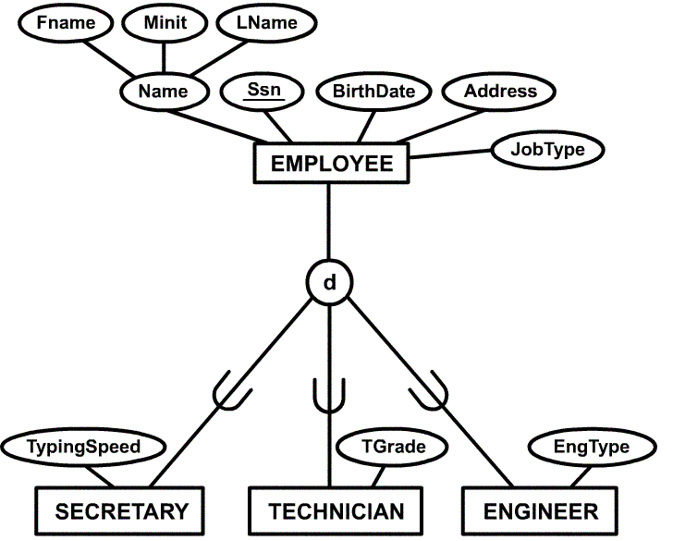
Example of a Specialization
subclass

Slide 13
Why we need specialization?
Certain attributes may apply to some but not all entities of the superclass
For example, SECRETARY subclass has specific attribute TypingSpeed
The other reason is that some relationship type may be participated in only by entities that are members of the subclass
For example, Only HOURLY_EMPLOYEES can belong to a trade union

Slide 14
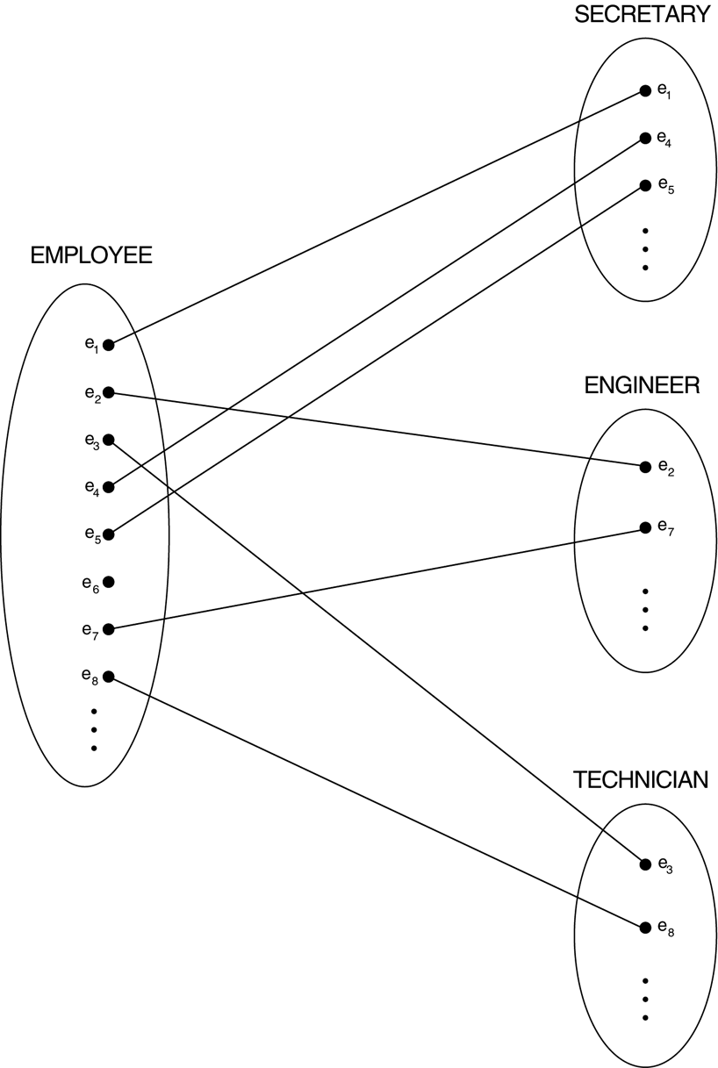
Instances of a specialization.
本範例是1:1 =>
兩邊關係一個對應一個
本範例是Partial=>部份參與,可以不對應。如e6

Slide 15
Generalization
Generalization is the reverse of the specialization process
Several classes with common features are generalized into a superclass;
original classes become its subclasses
Example: CAR, TRUCK generalized into VEHICLE;
both CAR, TRUCK become subclasses of the superclass VEHICLE.
We can view {CAR, TRUCK} as a specialization of VEHICLE
Alternatively, we can view VEHICLE as a generalization of CAR and TRUCK

Slide 16
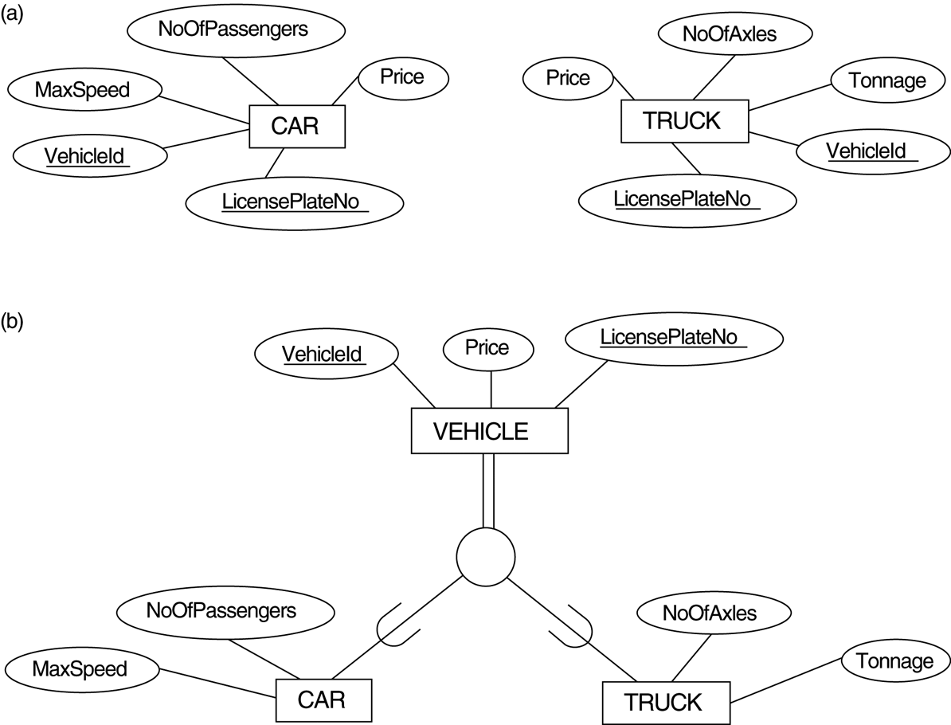
Generalization. (a) Two entity types, CAR and TRUCK. (b) Generalizing CAR and TRUCK into the superclass VEHICLE.

Slide 17
Constraints on Specialization and Generalization (1)
If we can determine exactly those entities that will become members of each subclass by a condition, the subclasses are called predicate-defined (or condition-defined) subclasses
Condition is a constraint that determines subclass members
Display a predicate-defined subclass by writing the predicate condition next to the line attaching the subclass to its superclass

Slide 18
Constraints on Specialization and Generalization (2)
If all subclasses in a specialization have membership condition on same attribute of the superclass, specialization is called an attribute-defined specialization
Attribute is called the defining attribute of the specialization
Example: JobType is the defining attribute of the specialization {SECRETARY, TECHNICIAN, ENGINEER} of EMPLOYEE
If no condition determines membership, the subclass is called user-defined
Membership in a subclass is determined by the database users by applying an operation to add an entity to the subclass
Membership in the subclass is specified individually for each entity in the superclass by the user

Slide 19
Attribute-defined specialization
FName
Minit
LName
defining attribute
Name
Ssn
BirthDate
Address
JobType
EMPLOYEE
Job Type
predicate condition
d
“Secretary”
“Engineer”
Typing Speed
“Technician”
TGrade
EngType
SECRETARY
TECHNICIAN
ENGINEER
Predicate defined subclass

Slide 20
Constraints on Specialization and Generalization (3)
Two other conditions apply to a specialization/generalization:
Disjointness (分離性限制) Constraint:
Specifies that the subclasses of the specialization must be disjointed (an entity can be a member of at most one of the subclasses of the specialization)
Specified by d in EER diagram
If not disjointed, overlap; that is the same entity may be a member of more than one subclass of the specialization
Specified by o in EER diagram
Completeness (完整性限制) Constraint:
Total specifies that every entity in the superclass must be a member of some subclass in the specialization/ generalization
Shown in EER diagrams by a double line
Partial allows an entity not to belong to any of the subclasses
Shown in EER diagrams by a single line

Slide 21
Predicate defined subclass
FName
Minit
LName
defining attribute
Name
Ssn
BirthDate
Address
JobType
EMPLOYEE
Partial constraint
Job Type
Disjointness constraint
d
“Secretary”
“Engineer”
predicate condition
Typing Speed
“Technician”
TGrade
EngType
SECRETARY
TECHNICIAN
ENGINEER
Predicate defined subclass

Slide 22
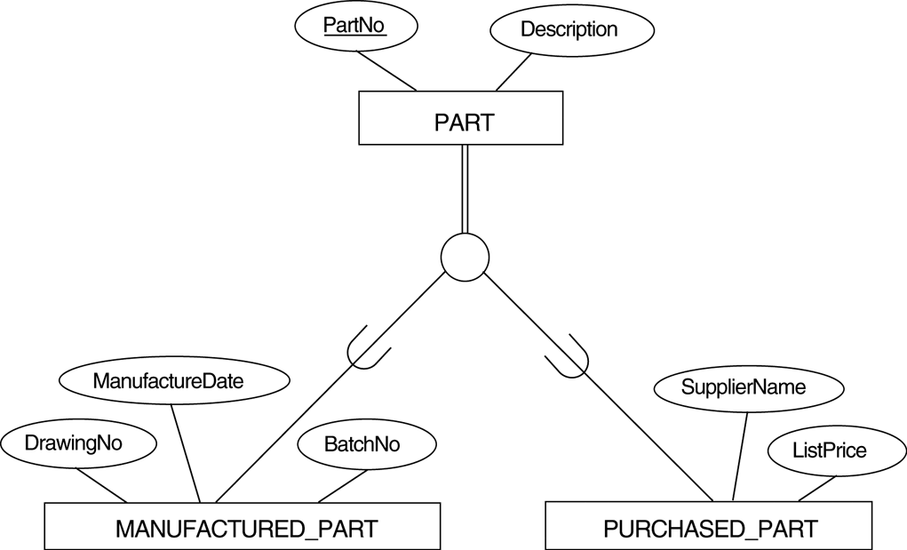
An Overlapping Specialization
Total specialization
Overlap
O

Slide 23
Constraints on Specialization and Generalization (4)
Hence, we have four types of specialization/generalization:
Disjoint, total
Disjoint, partial
Overlapping, total
Overlapping, partial
Note: Generalization usually is total because the superclass is derived from the subclasses.
Insert and Delete Rules
Deleting an entity from a superclass implies that it is automatically deleted from all the subclass
Inserting an entity in a superclass implied that it is inserted in all predicate-defined subclass
Inserting an entity in a total specialization superclass implied that it is inserted in at the least one of subclass

Slide 24
THANKS.

